Slide 1
Multi-Class Customer Category Prediction
Predicting customer category from purchase behavior using machine learning

Slide 2
Problem & Objective
Businesses treat all customers alike, missing chances to personalize offers
Goal: classify each customer into one of several categories from behavioral data
Enables targeted marketing, retention strategies and better recommendations
Deliverable: a trained multi-class model served through an interactive web app

Slide 3
Input Features
Age
Customer age in years
Previous Purchases
Count of past orders
Review Rating
Average rating given (numeric)
Frequency of Purchases
Categorical: e.g. Weekly, Fortnightly, Monthly
Subscription Status
Categorical: Yes / No

Slide 4
Modeling Pipeline
Data Collection
Preprocessing
Model Training
Evaluation
Deployment
Encode categorical features, scale numeric features, split into train/test sets, then compare classifiers.

Slide 5
Multi-Class Classification Approach
Target has 3+ classes, so models output a probability for every category
Candidate models: Logistic Regression, Decision Tree, Random Forest, Gradient Boosting
Metrics: accuracy, macro precision / recall / F1, confusion matrix
Cross-validation to guard against overfitting; pick best by macro F1

Slide 6
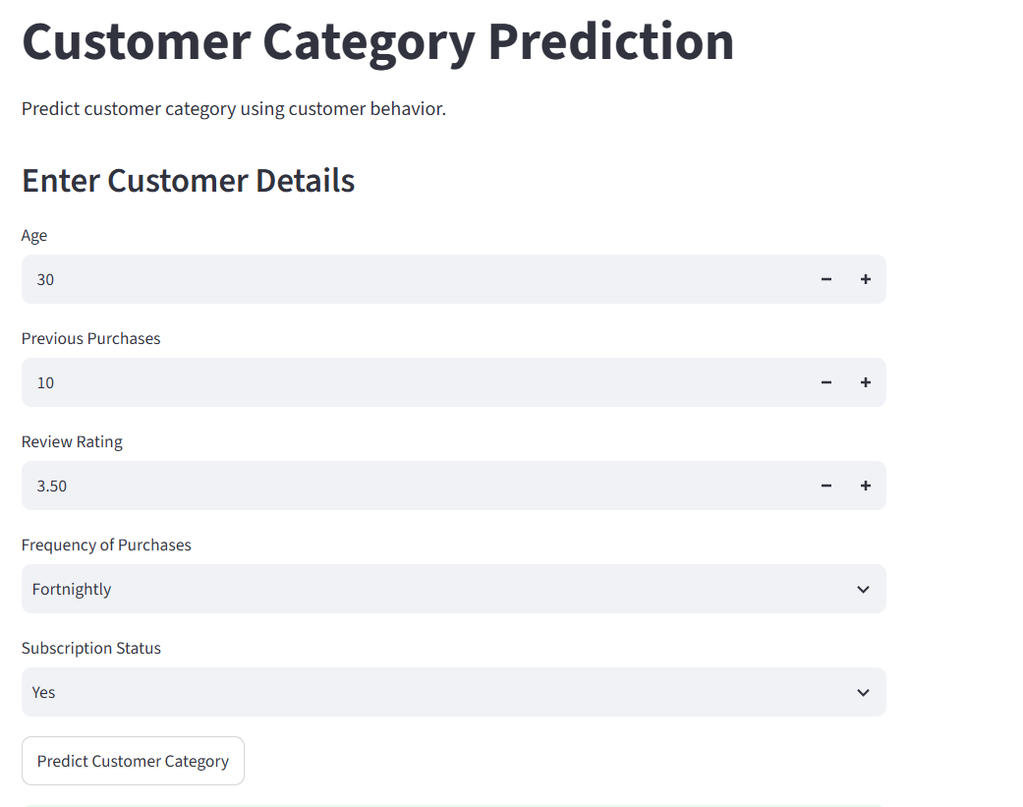
Web App Demo (Streamlit)
User enters age, purchases, rating, frequency and subscription
One click on "Predict Customer Category"
Model returns the predicted category instantly

Slide 7
Conclusion & Next Steps
Behavioral features can segment customers into actionable categories
The Streamlit app makes the model usable by non-technical teams
Next: add more features (spend, product type), tune hyperparameters, monitor drift
Next: connect predictions to marketing campaigns and measure uplift

